Slide 1



CSULA Senior Design Workshop
Noah Sager
Product Engineer | ArcGIS API for JavaScript | Esri
@noashx
nsager@esri.com
Notes:
Notes on these slides created by Noah Sager (current as of 10/09/2018)
https://noashx.github.io/presentations/CSULA/CSULA_Workshop_Sager.pptx
https://noashx.github.io/presentations/CSULA/CSULA_Workshop_Sager.pdf

Slide 2
About Me
Notes:
Who am I?

Slide 3



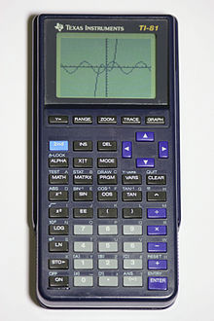


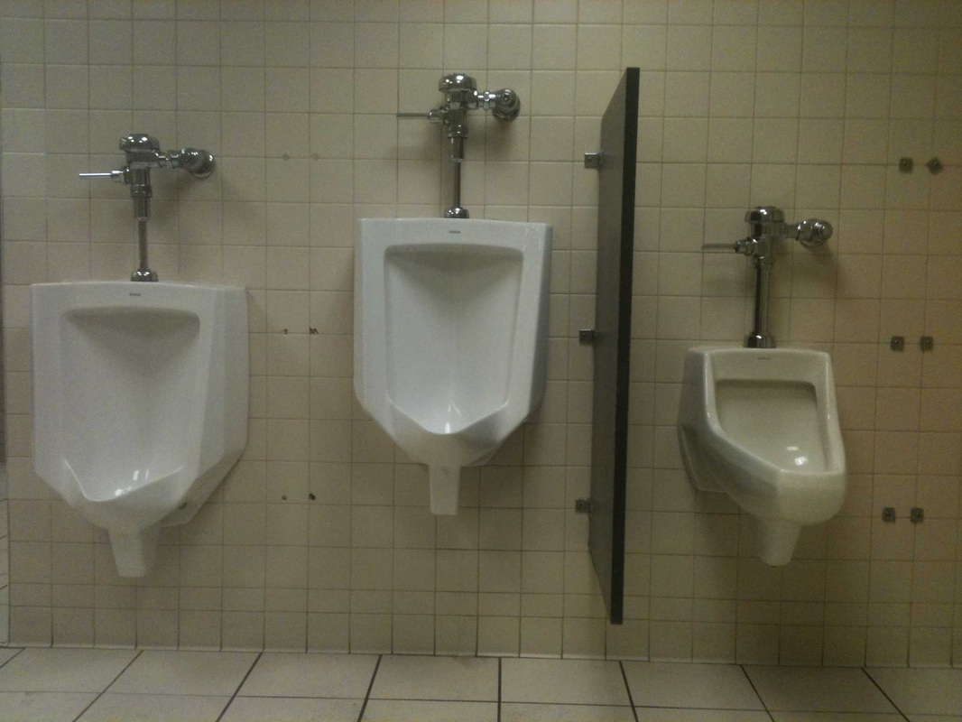

Notes:
A little about me:
First programming experience was on a TI-81 in high school. Made a few games and one “virus”.
Beautiful son
Beautiful daughter
Patriots fan since they drafted drew bledsoe in 1993
Studied squirrel foraging and anti-predator behavior in undergrad
Took a GIS approach to public restroom access in grad school
Before I came to esri they used my picture on promotional material, then after I grew a beard they hired me full time
And of course, I love working with computers

Slide 4
Now To Business
Notes:
Who am I?

Slide 5

What is…
Geography?
Notes:
Before we jump into the presentation, let’s talk about Geography, GIS, and ArcGIS. We want to figure out as a group where we are at on the following topics.
Ask the group…
What is….
Geography?
GIS?
ArcGIS?

Slide 6
Everything is related.
Things that are closer are more related than things that are farther away.
Notes:
Simple, clear, definition. Tobler’s first law of Geography.
https://en.wikipedia.org/wiki/Tobler%27s_first_law_of_geography

Slide 7
What is…
Geography?
GIS?
Notes:
Before we jump into the presentation, let’s talk about Geography, GIS, and ArcGIS. We want to figure out as a group where we are at on the following topics.
Ask the group…
What is….
Geography?
GIS?
ArcGIS?

Slide 8
Geographic Information System (GIS) lets us visualize, question, analyze, and interpret data to understand relationships, patterns, and trends. GIS benefits organizations of all sizes and in almost every industry.
Notes:
Dictionary definition

Slide 9
GIS is a tool/science/technology that collects, analyzes, and visualizes spatial relationships on a computer*.
Notes:
Working definition

Slide 10
What is…
Geography?
GIS?
ArcGIS?
Notes:
Before we jump into the presentation, let’s talk about Geography, GIS, and ArcGIS. We want to figure out as a group where we are at on the following topics.
Ask the group…
What is….
Geography?
GIS?
ArcGIS?

Slide 11
ArcGIS is an Esri GIS solution.
Desktop (Windows, Mac, Linux)
Mobile (Android, iOS, Windows)
Web (Chrome, IE, Opera, etc.)
Notes:
ArcGIS is an Esri GIS solution.

Slide 12

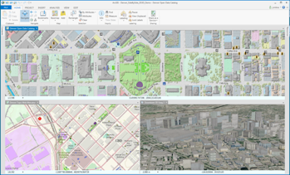
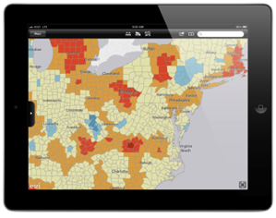
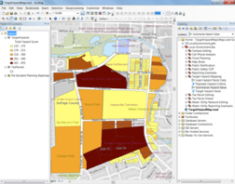
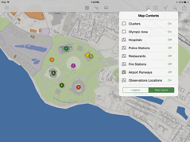
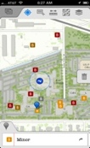
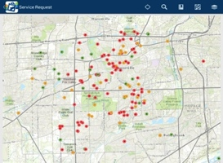


The ArcGIS Platform
ArcGIS Desktop
Apps
APIs & SDKs
http://
http://
http://
Maps
Scenes
ArcGIS Enterprise
(ArcGIS Server +
Portal for ArcGIS)
ArcGIS Online
Analytics
Feature
Layers
Scene Layers
Tile
Layers
Image
Layers
Analytics
Services
Data
Notes:
The ArcGIS Platform
All of this data is exposed through the geoinformation model as items that users and apps can work with.
These items are delivered by ArcGIS Online or ArcGIS Server.
Both have a portal that make these information items available to users.
The Apps, Desktop, APIs, and SDKs are all powered by this information.
All of this rests on a bed of services and data. The apps and users interact directly with the information from these services.
Today, we are focusing on the APIs & SDKs, specifically, the ArcGIS Runtime SDK for .NET.

Slide 13
What is…
Geography?
GIS?
ArcGIS?
GIS Programming?
Notes:
Before we jump into the presentation, let’s talk about Geography, GIS, and ArcGIS. We want to figure out as a group where we are at on the following topics.
Ask the group…
What is….
Geography?
GIS?
ArcGIS?

Slide 14
GIS Programming is a
kickbutt way to solve
geospatial problems in
a creative and totally relevant/unique workflow.
Notes:
If location matters, and programming is cool, then…

Slide 15

https://developers.arcgis.com
Notes:
https://developers.arcgis.com/

Slide 16
So what?

Slide 17
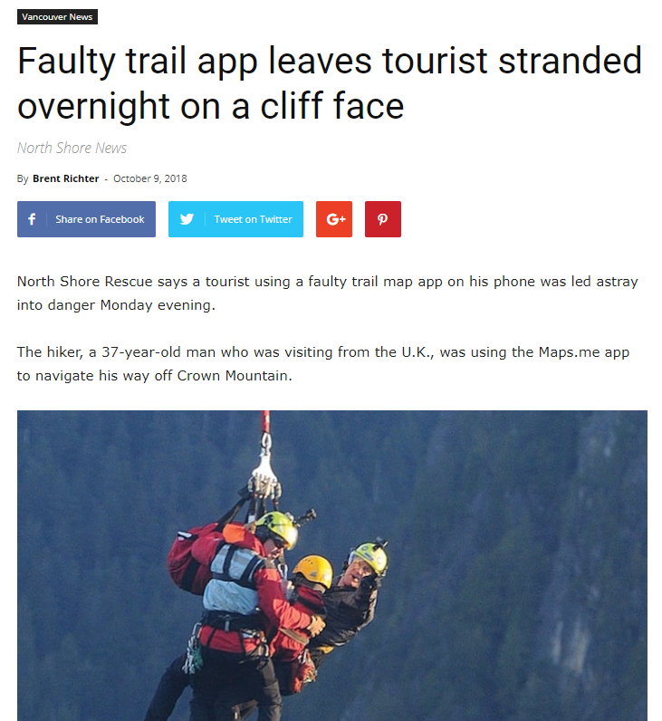
Notes:
https://www.vancouverisawesome.com/2018/10/09/tourist-app-stranded-crown-mountain-north-vancouver/

Slide 18
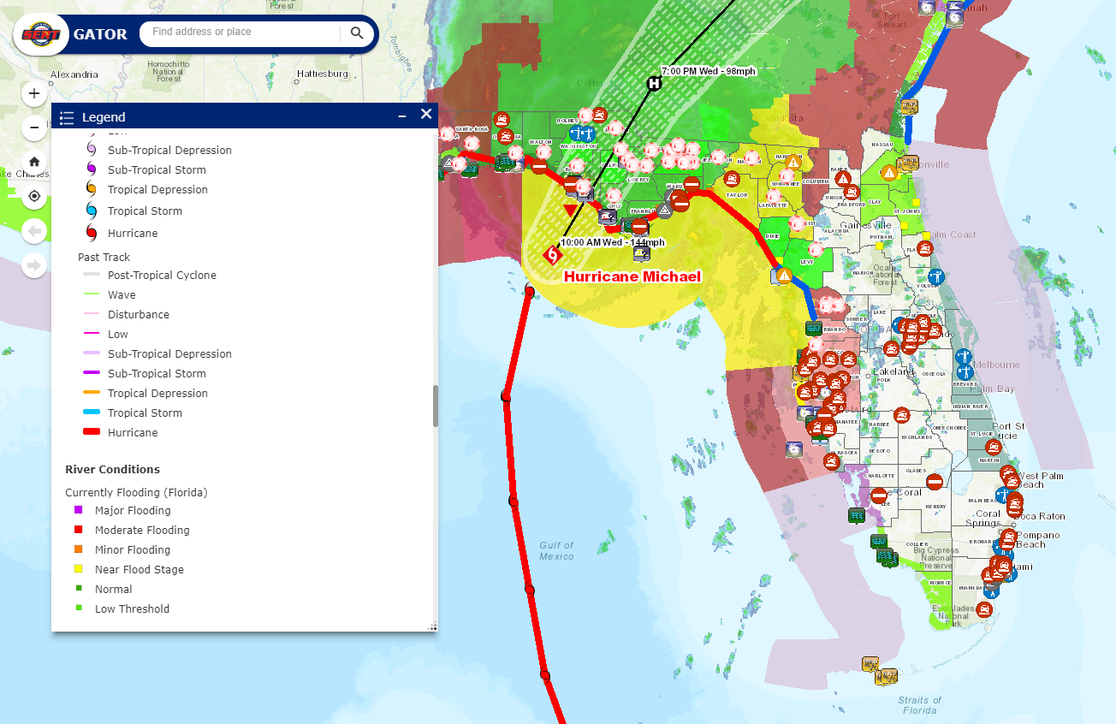
Notes:
https://floridadisaster.maps.arcgis.com/apps/webappviewer/index.html?id=f5628cfc02ca42b4a3853c69d8ff804b

Slide 19
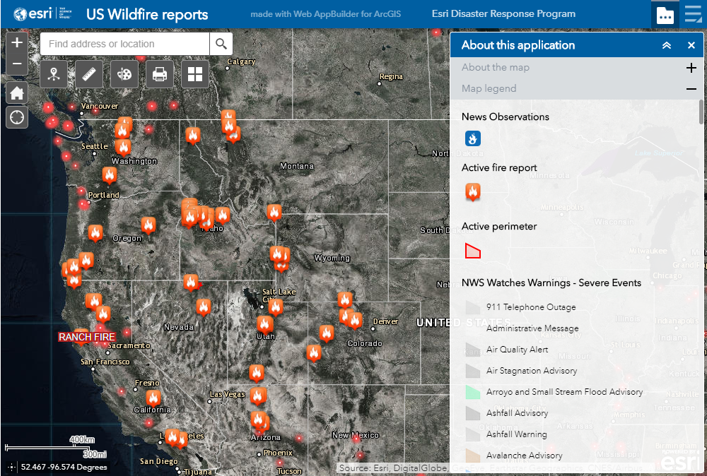
Notes:
https://www.esri.com/en-us/disaster-response/disasters/wildfires

Slide 20
ArcGIS API for JavaScript

Slide 21
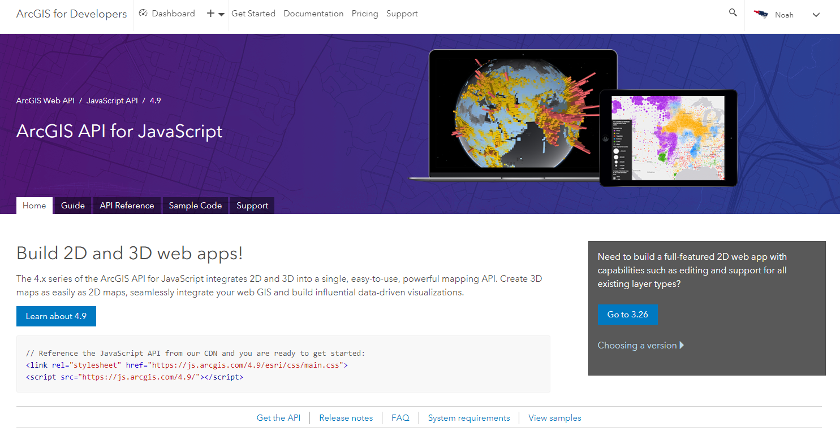
https://developers.arcgis.com/javascript
Notes:
https://developers.arcgis.com/javascript/index.html

Slide 22
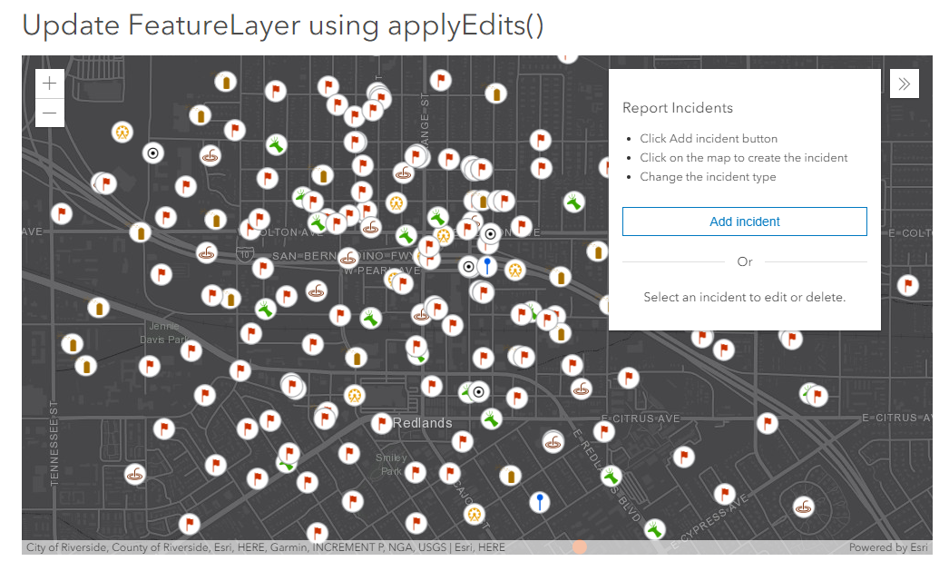
Notes:
https://developers.arcgis.com/javascript/latest/sample-code/editing-applyedits/index.html

Slide 23
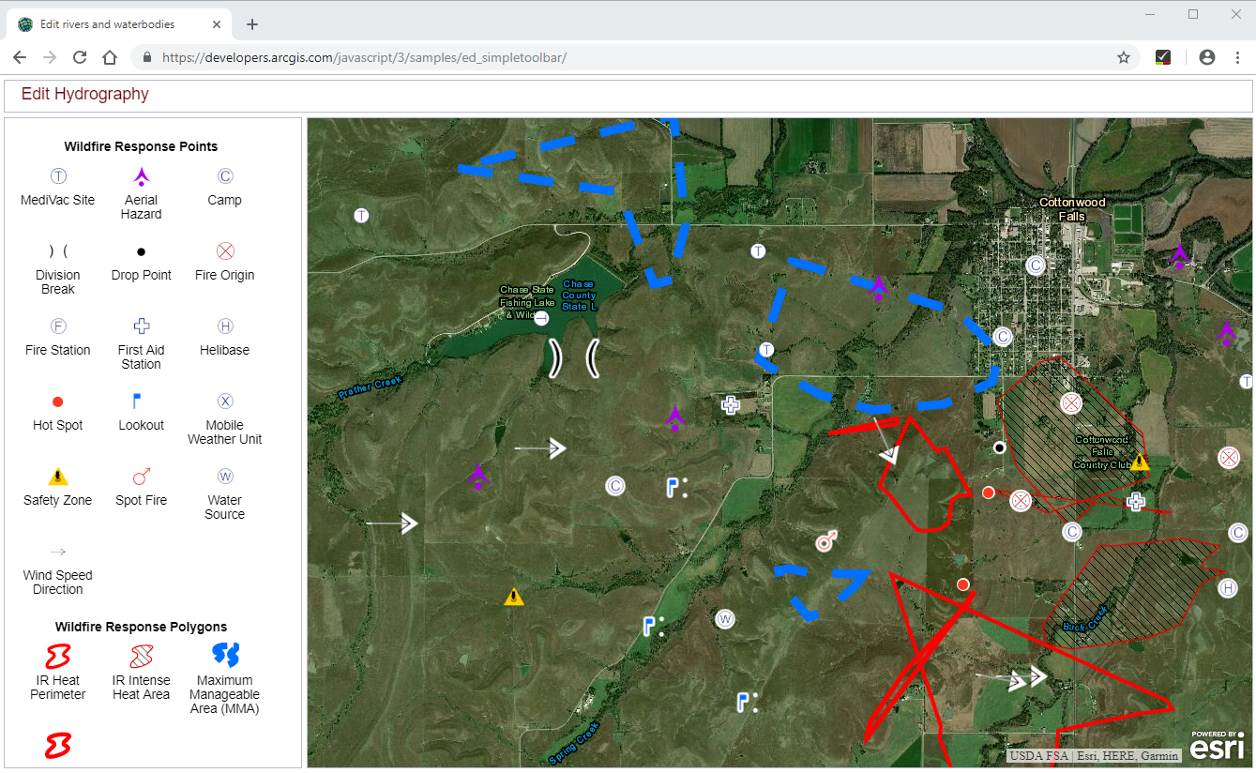
Notes:
https://developers.arcgis.com/javascript/3/jssamples/ed_simpletoolbar.html

Slide 24
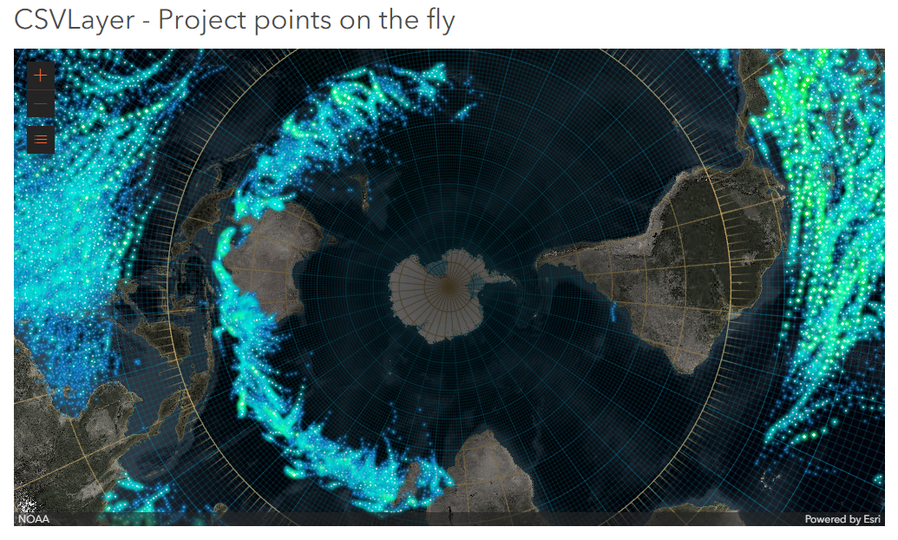
Notes:
https://developers.arcgis.com/javascript/latest/sample-code/layers-csv-projection/index.html

Slide 25
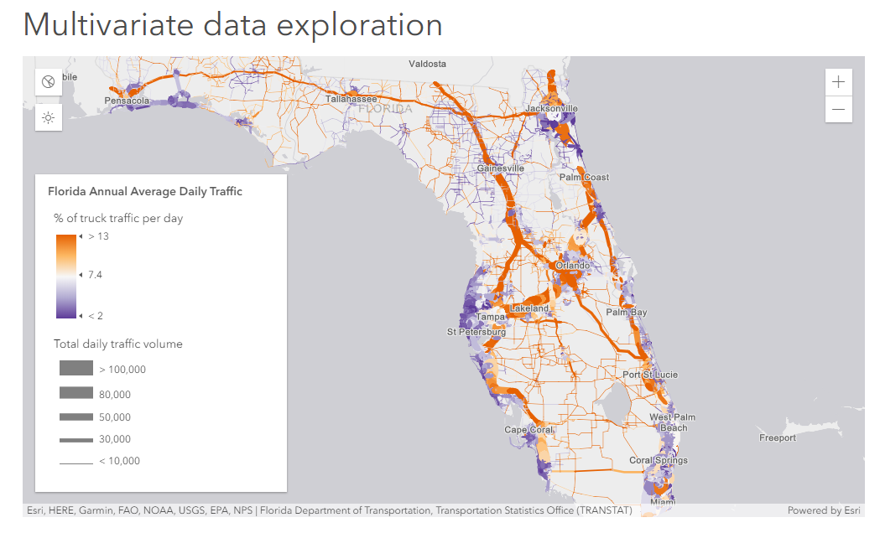
Notes:
https://developers.arcgis.com/javascript/latest/sample-code/visualization-sm-multivariate/index.html

Slide 26
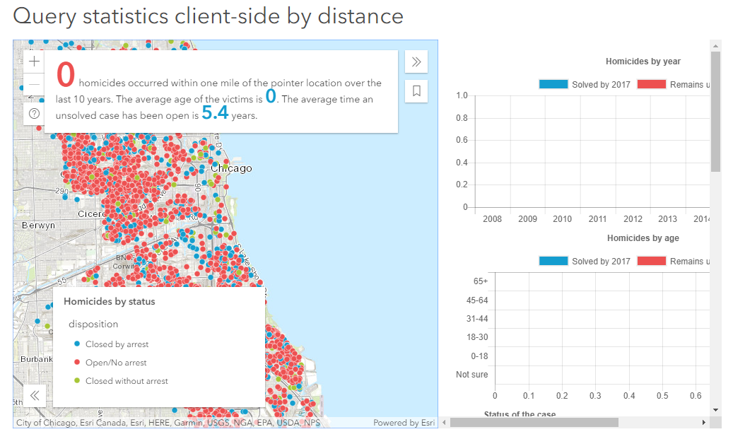
Notes:
https://developers.arcgis.com/javascript/latest/sample-code/featurelayerview-query-distance/index.html

Slide 27
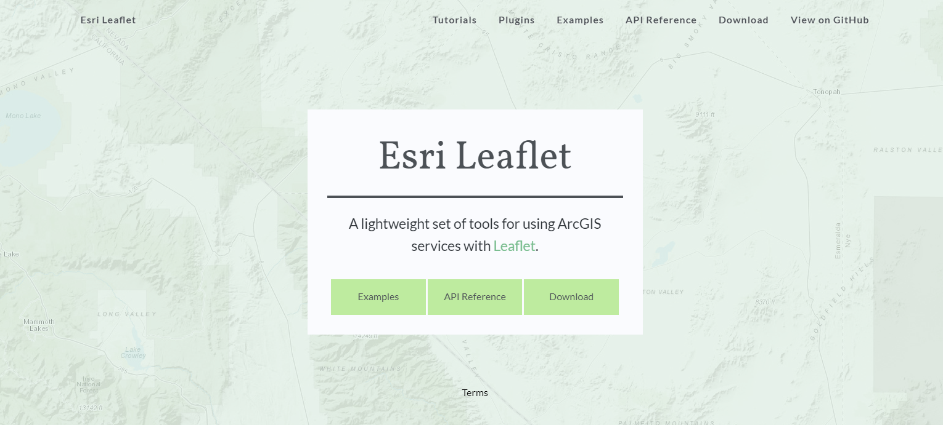
Notes:
http://esri.github.io/esri-leaflet/

Slide 28
Career Opportunities

Slide 29

https://www.esri.com/en-us/about/careers/student-jobs
Notes:
https://www.esri.com/en-us/about/careers/student-jobs

Slide 30



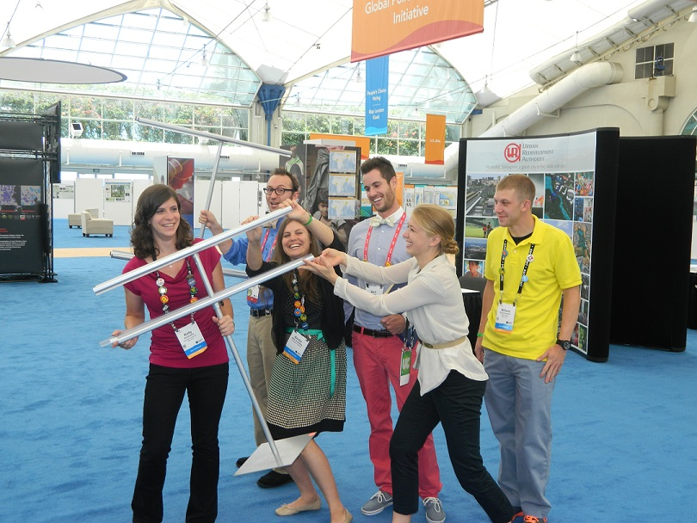

Notes:
http://www.esri.com/events/user-conference

Slide 31
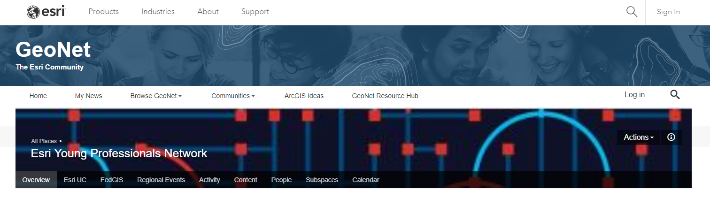
https://community.esri.com/community/esri-young-professionals-network
Notes:
https://community.esri.com/community/esri-young-professionals-network

Slide 32


https://community.esri.com/groups/geodev
@EsriGeoDev
Notes:
https://community.esri.com/groups/geodev
https://twitter.com/EsriGeoDev

Slide 33
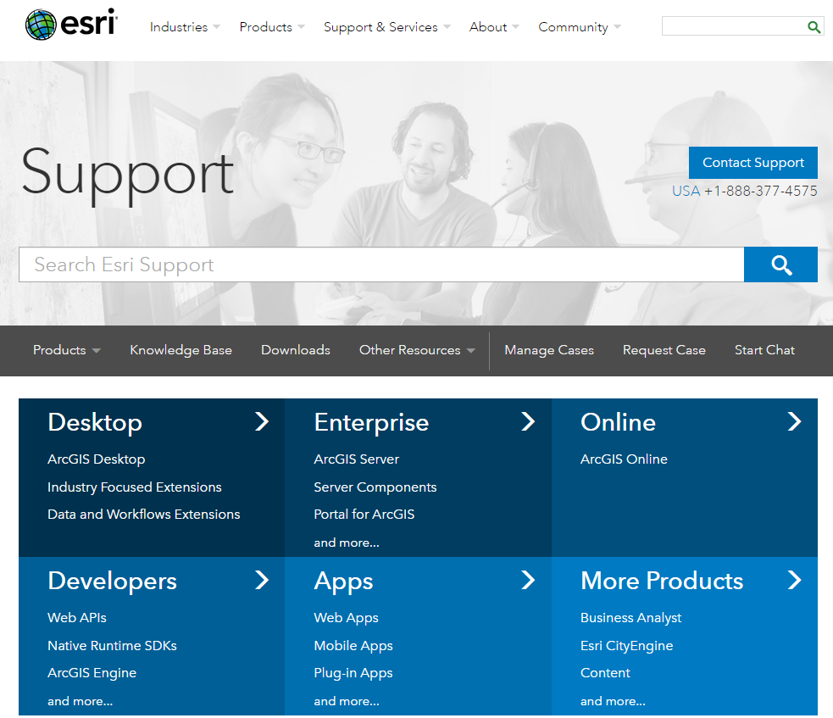
Notes:
http://support.esri.com/

Slide 34
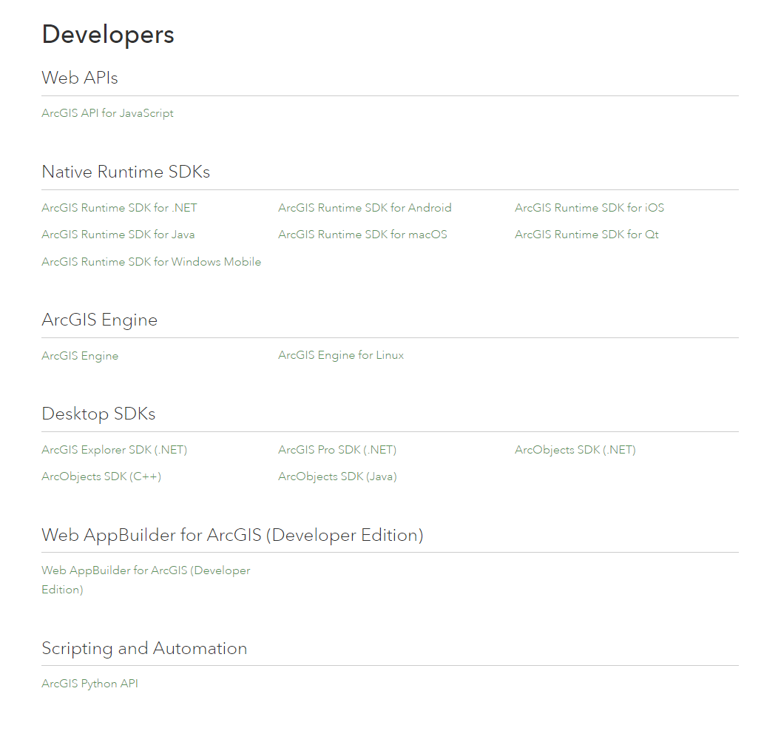
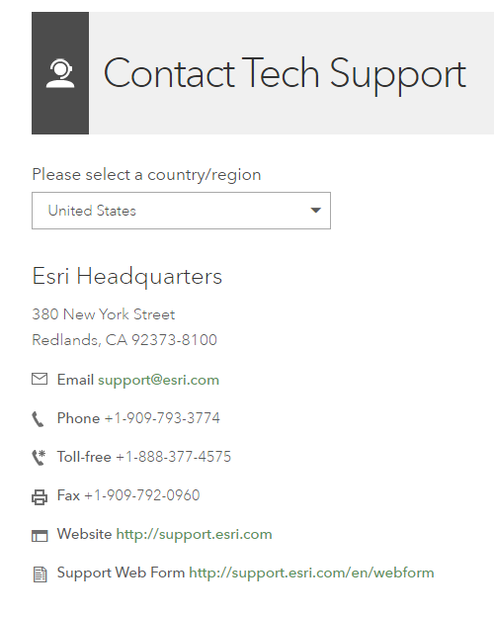
Notes:
http://support.esri.com/Products/Developers

Slide 35


Geomentoring
Notes:
http://www.esri.com/careers/main/student-jobs

Slide 36


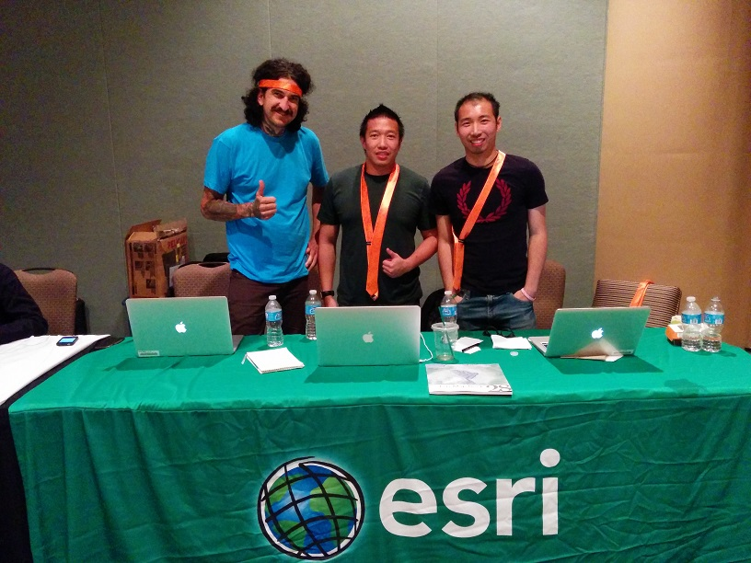
Hackathons
Notes:
Hackathons

Slide 37

Outreach
Notes:
Outreach

Slide 38
Unsolicited Advice
Notes:
You didn’t ask, but…

Slide 39
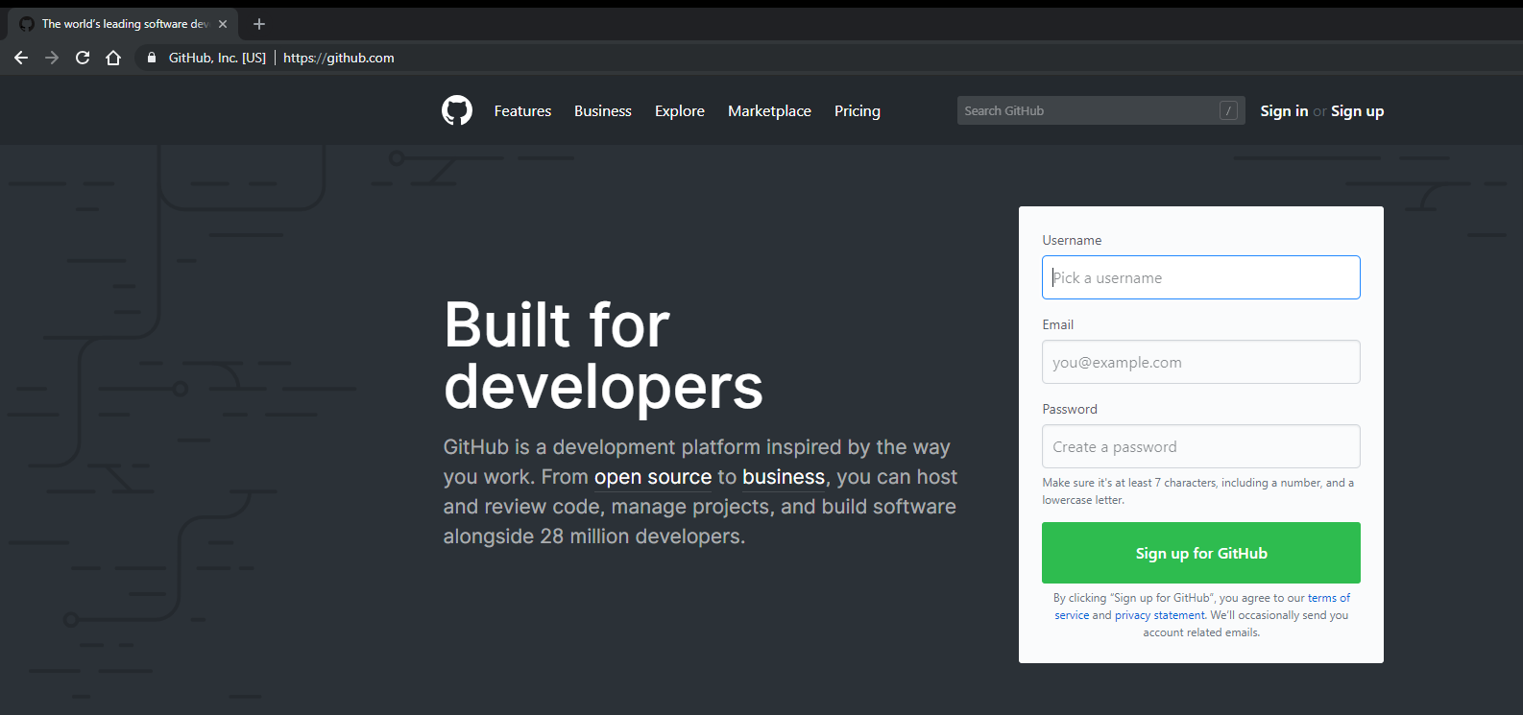

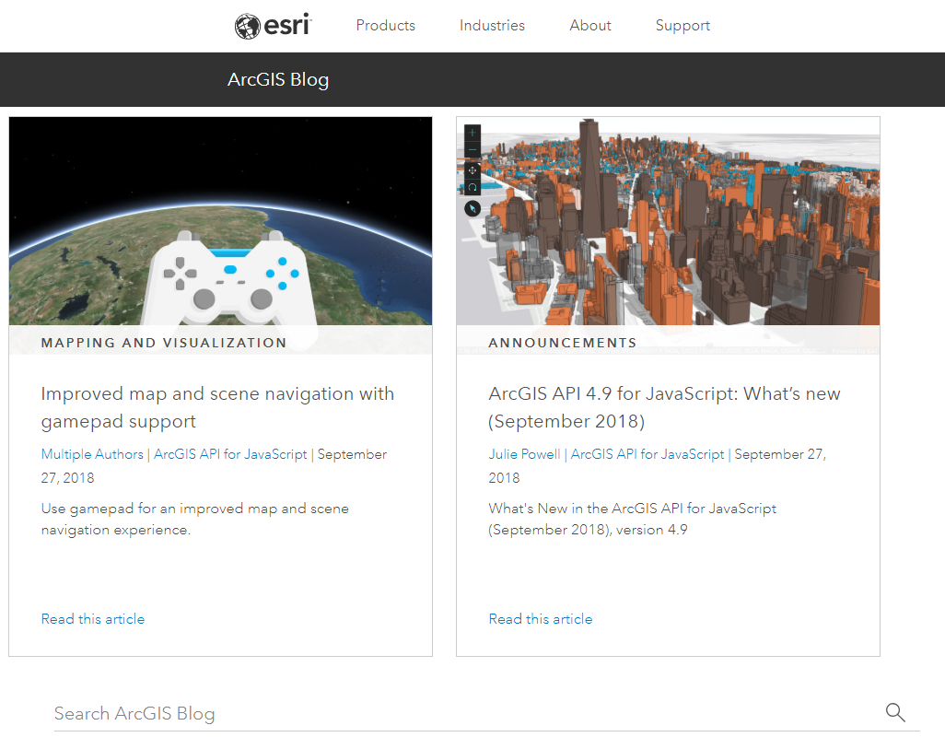


Slide 40
Thank you! Questions?
@noashx
nsager@esri.com

